Slide 1

Exploratory Data Analysis
WITH REAL TIME DATA

Slide 2
WHAT WE DO
We are a group of data scientists that are focusing on identifying certain traits in your data set
We have sat down as group to deep dive into your cosmetics data to help all stakeholders take data driven decisions
Our approach would be an analytical one. We will employ data visualization with R to represent data graphically

Slide 3

ROAD MAP
Involved the following steps:
We used the following libraries: completejourney, dplyr, ggplot2, stringr, lubridate, DT, scales.
Initialized complete datasets into data frames using the get_transactions() and get_promotions() functions.
We then spent a considerable amount of time to analyze data from your Cosmetics department.
We plotted graphs to better visualize your data by employing qualitative and quantitative metrics.

Slide 4
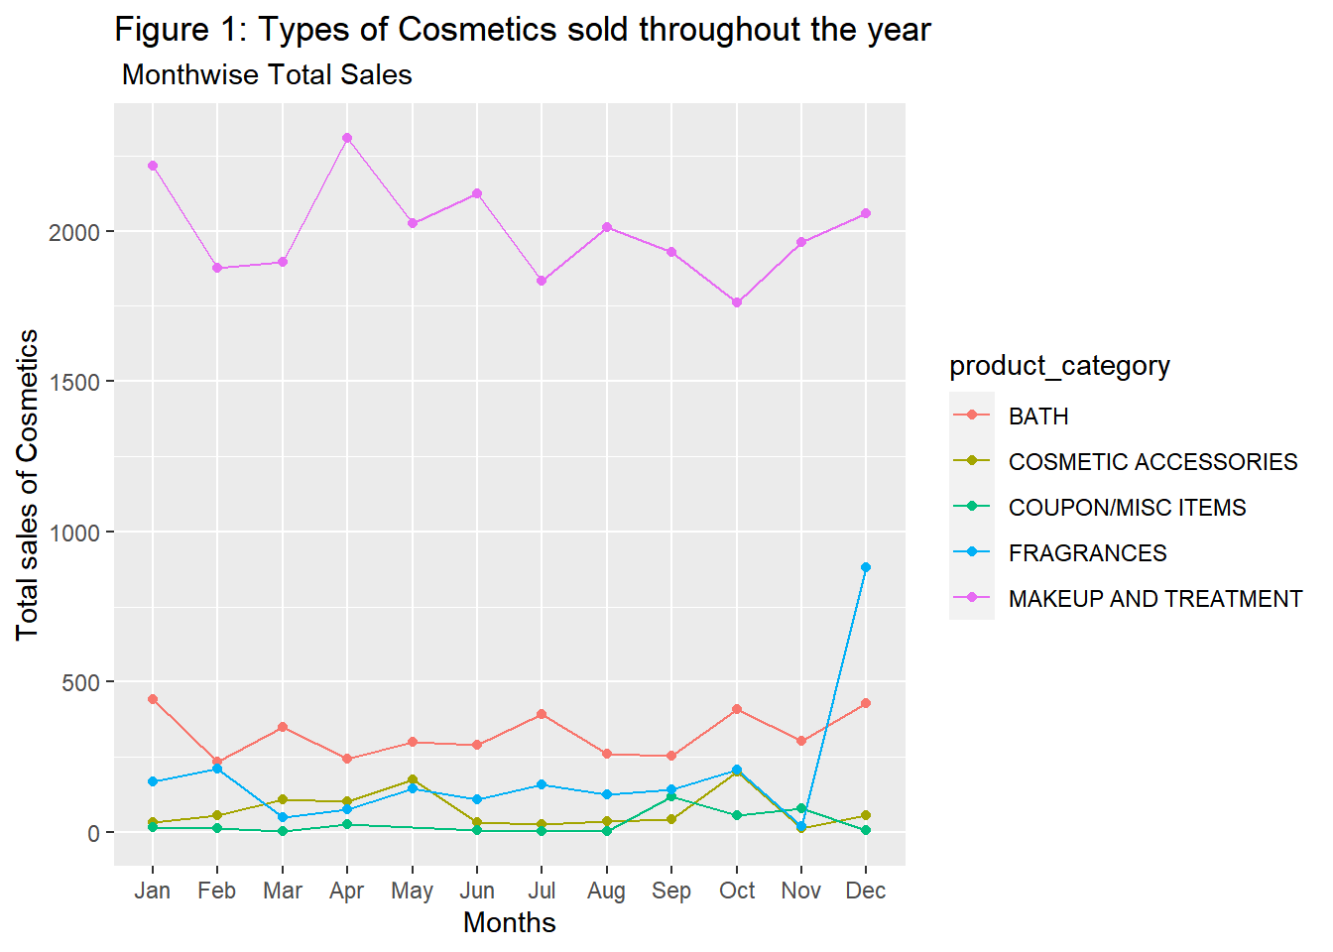
Products and sales over the year
The plot here shows the total sales of cosmetics over the course of the year against product category.
One interesting aspect to observe is that the fragrances sales shoot up from the November to December.
Notes:
In terms of total sales, we can depict that Makeup and Treatment are the most popular product categories and the other four products are far behind. One interesting aspect to observe is that the fragrances sales shoot up from the November month to the December month. Its probably because of the Christmas eve when most people purchase scents and fragrances to gift their loved ones.

Slide 5
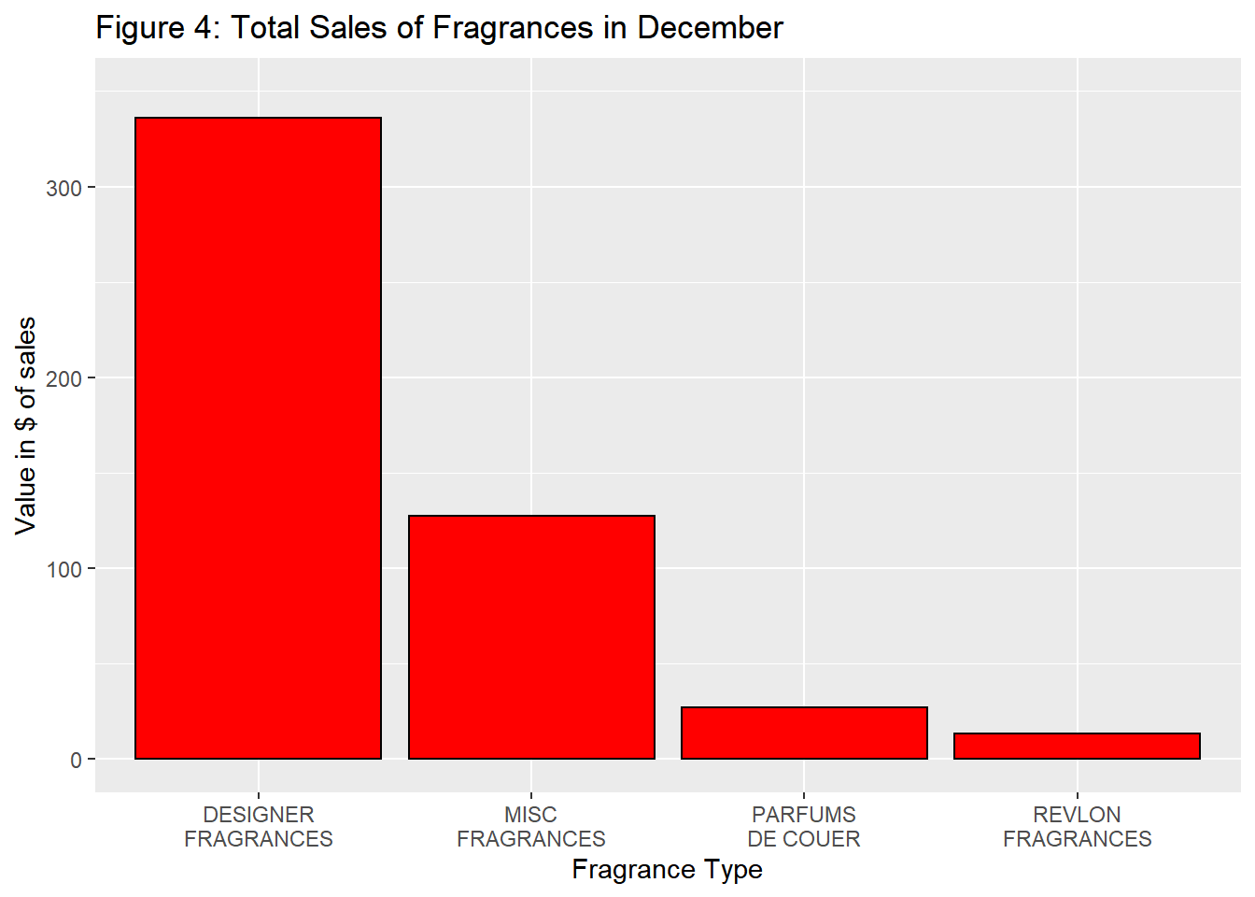
Deep dive!
We wanted to analyze the spike we saw in the first graph for the Monthly sales posted on all product categories.
PARFUMS DE COUER and REVLON fragrances have a very low sales value.

Slide 6
Cosmetics Department by Quantity
Table 1: Age Wise Sales in Cosmetics Department
 | Age | Categories | total_quant
1 | 45-54 | MAKEUP AND TREATMENT | 731
2 | 35-44 | MAKEUP AND TREATMENT | 717
3 | 25-34 | MAKEUP AND TREATMENT | 377
4 | 45-54 | BATH | 207
5 | 35-44 | BATH | 150
6 | 55-64 | MAKEUP AND TREATMENT | 142
7 | 65+ | MAKEUP AND TREATMENT | 91
8 | 19-24 | MAKEUP AND TREATMENT | 73
9 | 25-34 | BATH | 72
10 | 45-54 | COSMETIC ACCESSORIES | 30
A table was created to help you look at data.
The comparison is performed age-wise against categories and the sales in terms of quantity.
You can look at the data here under the exploratory data analysis section.

Slide 7
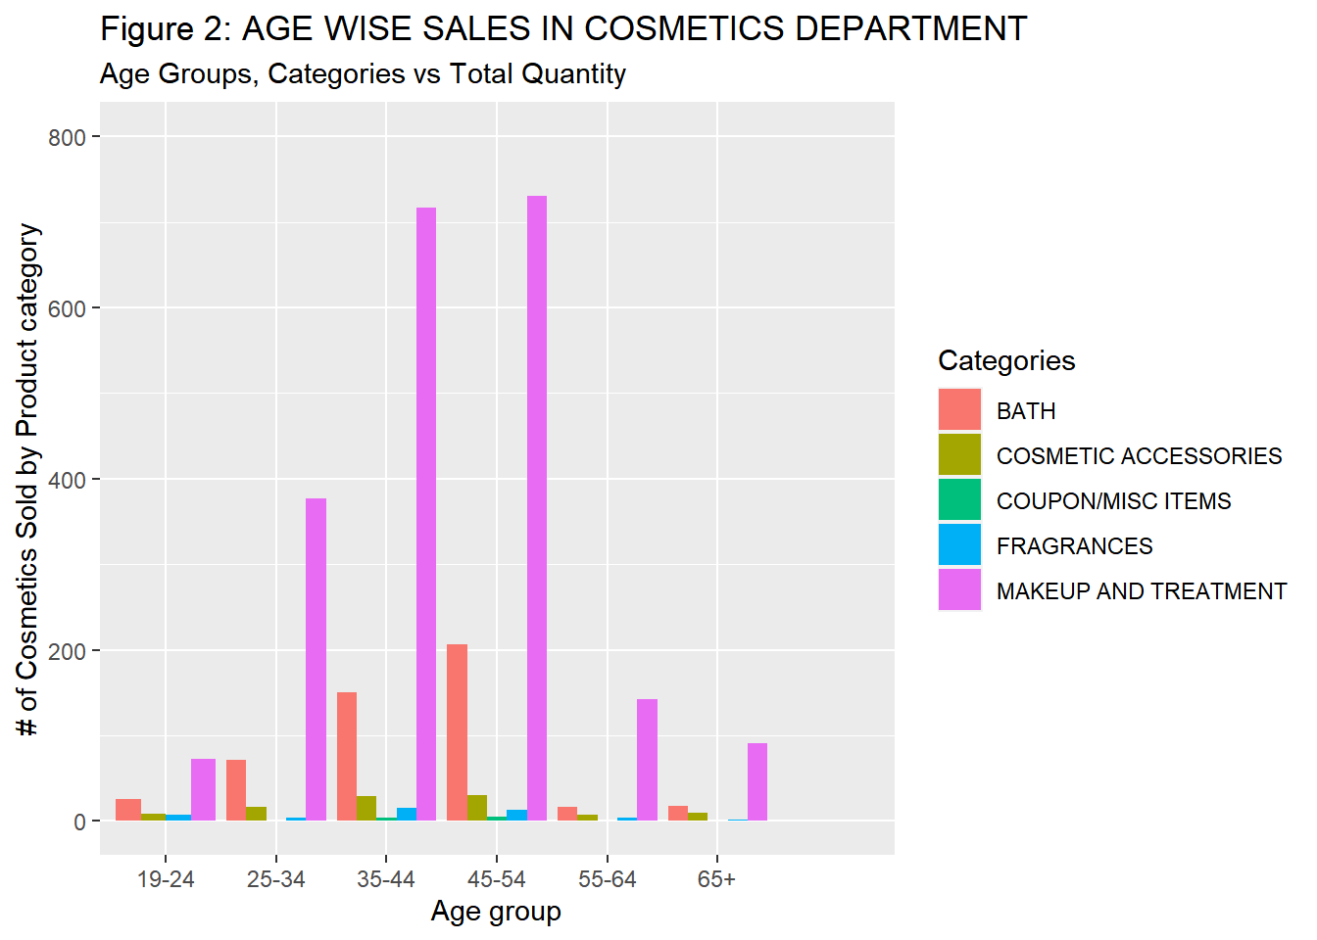
Representing graphically is always better!
In the graph, Age Groups 35-44 and 45-54 bought the highest number of MAKEUP AND TREATMENT ITEMS.
Target Audience → Age group(35-54)
Downside :-fragrances aren’t been purchased by a lot of age groups.

Slide 8
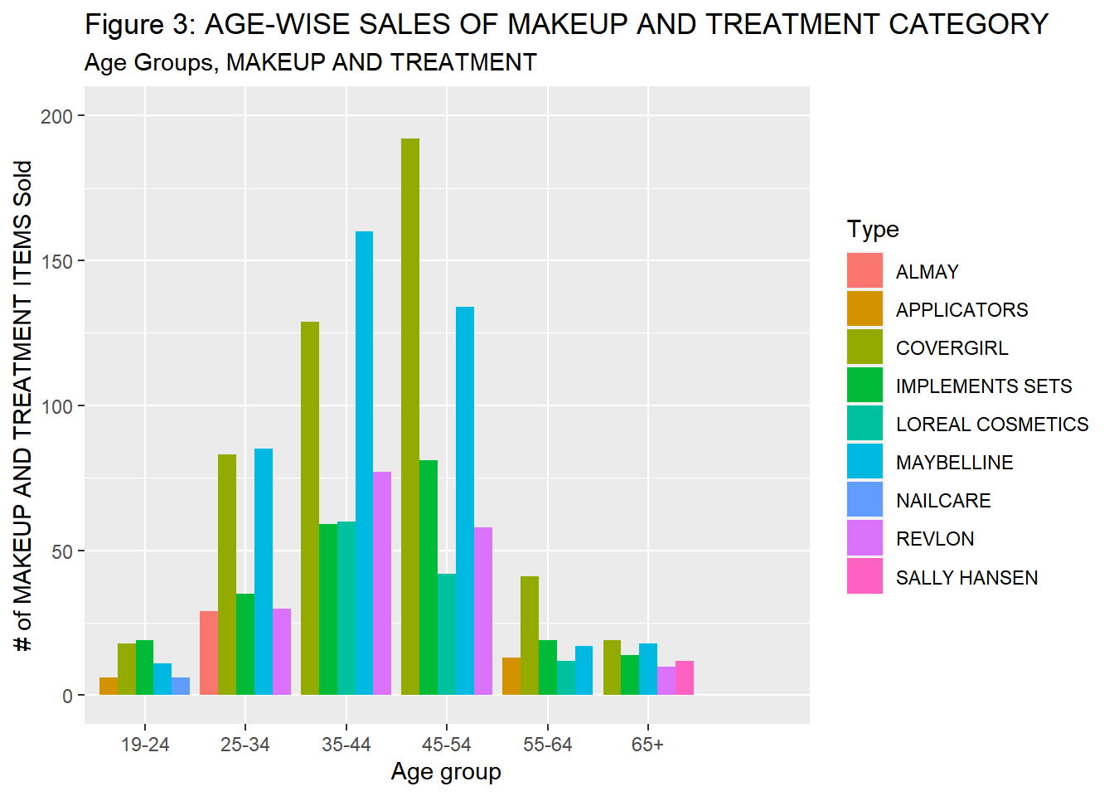
Makeup and Treatment Products
If we observe this graph carefully, we can clearly see that the same age group has higher purchases, but the top 5 products each of the group purchases are mostly inclined towards Maybelline and cover girl products.

Slide 9
Sales by product type and manufacturer
Table 2: Most Sold Product Sizes in Cosmetics Department: Makeup and treatment - Maybelline and Covergirl
 | product_type | package_size | manufacturer_id | Volume
1 | MAYBELLINE | 1 CT | 958 | 98
2 | COVERGIRL | .63 OZ | 373 | 28
3 | COVERGIRL | .29 OZ | 373 | 27
4 | COVERGIRL | .17 OZ | 373 | 20
5 | COVERGIRL | .37 OZ | 25 | 16
6 | COVERGIRL | .33 OZ | 373 | 15
7 | COVERGIRL | .39 OZ | 373 | 11
8 | COVERGIRL | .42 OZ | 373 | 11
9 | COVERGIRL | .94 OZ | 25 | 9
10 | COVERGIRL | .12 OZ | 1364 | 8
11 | COVERGIRL | .43 OZ | 373 | 5
12 | COVERGIRL | 1 OZ | 373 | 5
13 | COVERGIRL | .27 OZ | 373 | 4
14 | COVERGIRL | .13 OZ | 373 | 2
15 | COVERGIRL | .2 OZ | 373 | 2
16 | COVERGIRL | .24 OZ | 373 | 2
17 | COVERGIRL | 1.35 OZ | 373 | 2
18 | COVERGIRL | .19 OZ | 1364 | 1
19 | COVERGIRL | 1.4 OZ | 373 | 1
20 | MAYBELLINE | EMERALD | 958 | 1
If we observe carefully, the Maybelline product is mostly sold in that 1 CT package size. Covergirl on the other hand has different package sizes being sold. So, these sizes are something the manufacturers can specifically focus on.

Slide 10
Rundown!
Our problem statement is to identify trends in the sale of products in the Cosmetics Department to be able to help Regork take better data-driven decisions for this department.
Figure 1: Makeup and treatment products sell the most, while the other product lines lag in terms of sales. Interesting thing to note is that fragrances sales spike in the month of December probably due to Christmas. We will drill down to see the products that didn’t go well in sales during this period to better promote them next year.
Figure 2: Here, we have used the demographics data to identify the usual target audience for your products. Its interesting to note that the age groups 35-54 have purchased a lot in the makeup product category line.
Figure 3: In here, we’ve drilled down on top of Figure 2 to see what are the top 5 products purchased by the same age groups. Maybelline and Covergirl are the standouts in this regard.
Table 2: This table was visualized to assist Regork identify the manufacturers that manufacture a specific size for the Maybelline and cover girl product range. We have aggregated the sales by quantity to show that package sizes sell more than certain others. However, the overall sales of cover girl across various package sizes is still higher.

Slide 11
This is what we Propose
So, providing bigger discounts on products that they’re interested in will enhance their sales well. This will attract buyers from age groups 35-54 as well.
We will have to find intrinsic details - probably perform a sentiment analysis to see why customers are not purchasing these products(bath, cosmetic accessories and fragrances).
Report the table to the manufacturers of Maybelline, cover girl and various fragrances to help them visualize the demand and get them to increase the supply during the month of December

Slide 12
Limitations and dependencies
We wanted to identify package sizes that sell a lot. I believe we would’ve had more interesting facts if there was no such data quality issue.
Our analysis couldn’t find out why only the makeup sales soar up while the others are falling behind.
We were looking for geographical metrics to plot heat maps where maximum sales occur, however, there was no such metric readily available.

Slide 13

Thank you!

